Slide 1
Design and Implementation

Slide 2
Topics covered
Object-oriented design using the UML
System Context and Interaction
Architectural Design
Object Class Identification
Design Models
Interface Specification

Slide 3
Design and implementation
Software design and implementation is the stage in the software engineering process at which an executable software system is developed.
Software design and implementation activities are invariably inter-leaved.
Software design is a creative activity in which you identify software components and their relationships, based on a customer’s requirements.
Implementation is the process of realizing the design as a program.

Slide 4
Build or buy
In a wide range of domains, it is now possible to buy off-the-shelf systems (COTS) that can be adapted and tailored to the users’ requirements.
For example, if you want to implement a medical records system, you can buy a package that is already used in hospitals. It can be cheaper and faster to use this approach rather than developing a system in a conventional programming language.
When you develop an application in this way, the design process becomes concerned with how to use the configuration features of that system to deliver the system requirements.

Slide 5
An object-oriented design process
Structured object-oriented design processes involve developing a number of different system models.
They require a lot of effort for development and maintenance of these models and, for small systems, this may not be cost-effective.
However, for large systems developed by different groups design models are an important communication mechanism.

Slide 6
Process stages
There are a variety of different object-oriented design processes that depend on the organization using the process.
Common activities in these processes include:
Define the context and modes of use of the system;
Design the system architecture;
Identify the principal system objects;
Develop design models;
Specify object interfaces.
Process illustrated here using a design for a wilderness weather station.

Slide 7
System context and interactions
Understanding the relationships between the software that is being designed and its external environment is essential for deciding how to provide the required system functionality and how to structure the system to communicate with its environment.
Understanding of the context also lets you establish the boundaries of the system. Setting the system boundaries helps you decide what features are implemented in the system being designed and what features are in other associated systems.

Slide 8
Context and interaction models
A system context model is a structural model that demonstrates the other systems in the environment of the system being developed.
An interaction model is a dynamic model that shows how the system interacts with its environment as it is used.

Slide 9
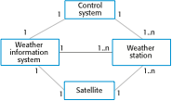
Interaction Model for Weather station

Slide 10
UML diagram types
Use case diagrams, which show the interactions between a system and its environment.
Sequence diagrams, which show interactions between actors and the system and between system components.

Slide 11
Use case modeling
Use cases were developed originally to support requirements elicitation and now incorporated into the UML.
Each use case represents a discrete task that involves external interaction with a system.
Actors in a use case may be people or other systems.
Represented diagrammatically to provide an overview of the use case and in a more detailed textual form.

Slide 12

Transfer-data use case
A use case in the MHC-PMS

Slide 13
Use Case Models: Actors (1)
An actor is a direct external user of a system
An object or a set of objects that communicates directly with the system but that is not a part of the system.
Each actor represents those objects that behave in a particular way toward the system.
Examples:
Vending Machine
Customer
Repair technician
Computer Database system
User
Administrator

Slide 14
Use Case Models: Actors (2)
Actors can be persons, devices, and other systems
An actor has a single well-defined purpose (role).
An actor represents a particular facet of objects in its interaction with a system,
Each actor represents a coherent set of capabilities for its objects.
Modeling the actors helps to define a system by identifying the object within the system and those on its boundary.
An actor is directly connected to the system.

Slide 15
System boundaries
System boundaries are established to define what is inside and what is outside the system.
They show other systems that are used or depend on the system being developed.
The position of the system boundary has a profound effect on the system requirements.
Defining a system boundary is a political judgment
There may be pressures to develop system boundaries that increase / decrease the influence or workload of different parts of an organization.

Slide 16
Use Case Models: Use cases (1)
A use case is a coherent piece of functionality that a system can provide by interacting with actors.
Example:
A customer actor can buy a beverage from a vending machine: it inserts money into machine, make a selection, and ultimately receive a beverage and eventually change.
Each use case involves one or more actors as well as the system itself:
In a telephone system, the use case “make a call” involves two actors, a caller and a receiver.
ِA use case involves a sequence of messages among the system and its actors.
A customer inserts a coin and the vending machine displays the amount deposited…….. Then the customer pushes a button to indicate a selection; the vending machine dispenses the selected beverage and issues change if necessary

Slide 17
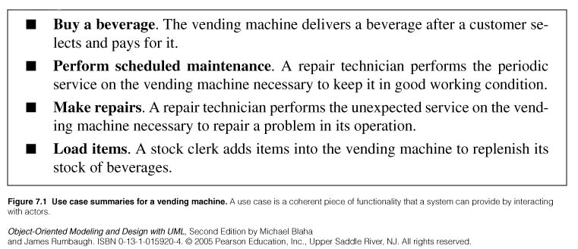
Use Case Models: Use cases (2)

Slide 18
Use Case Models: Use cases (3)
Some use cases have a fixed sequence of messages.
Error conditions are also part of a use case:
Examples:
Selecting a beverage whose supply is exhausted , the vending machine displays a warning message
Vending transaction can be canceled
The designer should plan for all possible behaviors sequences. User errors, or resource failures are just additional kinds of behavior that a robust system can accommodateز

Slide 19
Use Case Models: Use cases (4)
A use case brings together all of the behavior relevant to a slice of a system functionality:
This includes normal mainline behavior, variations on normal behavior, exceptions conditions, error conditions, and cancellation of a requestز
Grouping normal and abnormal behavior under a single use case helps to ensure that all consequences of an interaction are considered together.
In a complete model, the uses cases partition the functionality of the systems:
They should preferably all be at a comparable level of abstraction:
Make phone call, record voice message are comparable levels
Set external speaker volume to high is too narrow.
Better to define a use case set telephone parameters under which we might regroup setting volume, display pad settings, setting clock….

Slide 20
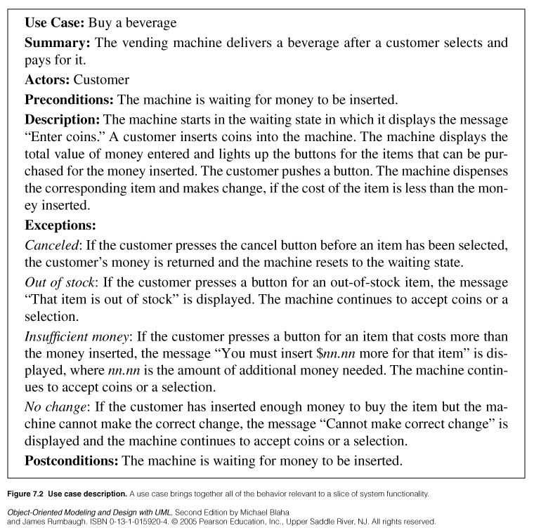

Slide 21
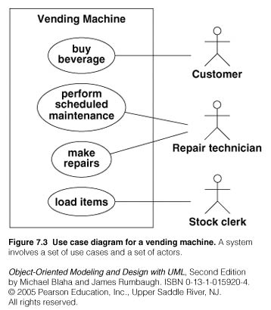

Slide 22
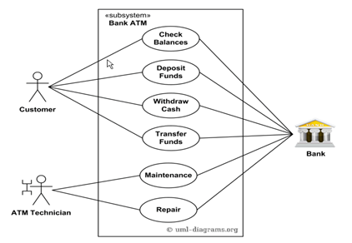
Design a Use-case diagram for Bank ATM system.

Slide 23
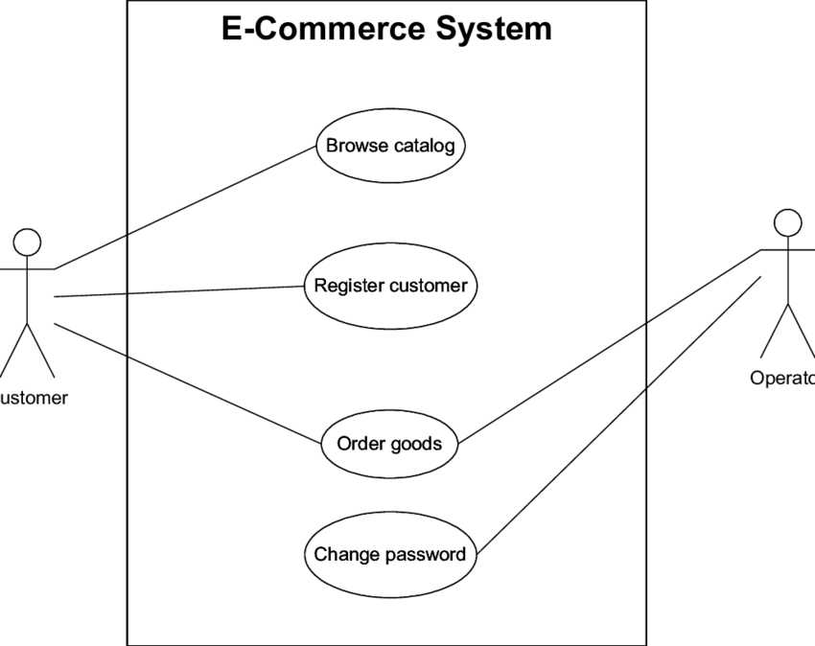

Slide 24
Guidelines for use case Models
First determine the system boundary
Ensure that actors are focused:
Each actor should have a single, coherent purpose. If a real-world object embodies multiple purposes, capture them with separate actors. For example, the owner of a personal computer may install software, set up a database, and send email. These functions differ greatly in their impact on the computer system and the potential for system damage. They might be broken into three actors: system administrator, database administrator, and computer user. Remember that an actor is defined with respect to a system, not as a free-standing concept.
Each use case must provide value to users:
Should represent a complete transaction that produces value to users.
Ex: dial a phone number is not a good use case. It does not represent a complete transaction of value by itself. It s merely a part of the use case make a call.

Slide 25
Guidelines for use case Models
Relate use cases and actors:
Each use case should have at least one actor
Every actor must participate in at least one use case
A use case may involve several actors (one of them is the primary actor and the others are the secondary actors)
An actor may participate in several use cases.
Remember that use cases are informal
Is acceptable if use cases are a bit loose at first. Detail can come later as use cases are expanded and mapped into implementations.
Use cases can be structured.

Slide 26
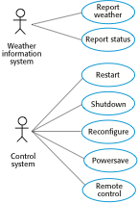
Weather station use cases

Slide 27
Use case description—Report weather
System | Weather station
Use case | Report weather
Actors | Weather information system, Weather station
Description | The weather station sends a summary of the weather data that has been collected from the instruments in the collection period to the weather information system. The data sent are the maximum, minimum, and average ground and air temperatures; the maximum, minimum, and average air pressures; the maximum, minimum, and average wind speeds; the total rainfall; and the wind direction as sampled at five-minute intervals.
Stimulus | The weather information system establishes a satellite communication link with the weather station and requests transmission of the data.
Response | The summarized data is sent to the weather information system.
Comments | Weather stations are usually asked to report once per hour but this frequency may differ from one station to another and may be modified in the future.

Slide 28
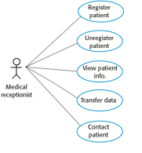
Use cases in the MHC-PMS involving the role ‘Medical Receptionist’

Slide 29
Design a Use-case diagram for Bank ATM system.

Slide 31
Additional Notes : LIBSYS use cases

Slide 32
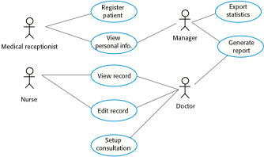
Use cases for the MHC-PMS

Slide 33
Architectural design
Once interactions between the system and its environment have been understood, you use this information for designing the system architecture.
You identify the major components that make up the system and their interactions, and then may organize the components using an architectural pattern such as a layered or client-server model.
The weather station is composed of independent subsystems that communicate by broadcasting messages on a common infrastructure.

Slide 34
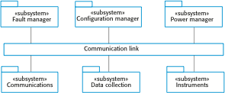
High-level architecture of the weather station

Slide 35
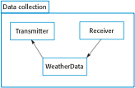
Architecture of data collection system

Slide 36
Object class identification
Identifying object classes is often a difficult part of object oriented design.
There is no 'magic formula' for object identification. It relies on the skill, experience and domain knowledge of system designers.
Object identification is an iterative process. You are unlikely to get it right first time.

Slide 37
Approaches to identification
Use a grammatical approach based on a natural language description of the system (used in Hood OOD method).
Base the identification on tangible things in the application domain.
Use a behavioural approach and identify objects based on what participates in what behaviour.
Use a scenario-based analysis. The objects, attributes and methods in each scenario are identified.

Slide 38
Weather station description
A weather station is a package of software controlled instruments which collects data, performs some data processing and transmits this data for further processing. The instruments include air and ground thermometers, an anemometer, a wind vane, a barometer and a rain gauge. Data is collected periodically.
When a command is issued to transmit the weather data, the weather station processes and summarises the collected data. The summarised data is transmitted to the mapping computer when a request is received.

Slide 39
Weather station object classes
Object class identification in the weather station system may be based on the tangible hardware and data in the system:
Ground thermometer, Anemometer, Barometer
Application domain objects that are ‘hardware’ objects related to the instruments in the system.
Weather station
The basic interface of the weather station to its environment. It therefore reflects the interactions identified in the use-case model.
Weather data
Encapsulates the summarized data from the instruments.

Slide 40
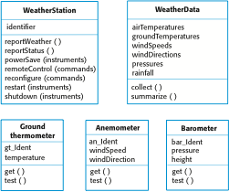
Weather station object classes

Slide 41
Design models
Design models show the objects and object classes and relationships between these entities.
Static models describe the static structure of the system in terms of object classes and relationships.
Dynamic models describe the dynamic interactions between objects.

Slide 42
Examples of design models
Subsystem models that show logical groupings of objects into coherent subsystems.
Sequence models that show the sequence of object interactions.
State machine models that show how individual objects change their state in response to events.
Other models include use-case models, aggregation models, generalisation models, etc.

Slide 43
Subsystem models
Shows how the design is organised into logically related groups of objects.
In the UML, these are shown using packages - an encapsulation construct. This is a logical model. The actual organisation of objects in the system may be different.

Slide 44
Sequence models
Sequence models show the sequence of object interactions that take place
Objects are arranged horizontally across the top;
Time is represented vertically so models are read top to bottom;
Interactions are represented by labelled arrows, Different styles of arrow represent different types of interaction;
A thin rectangle in an object lifeline represents the time when the object is the controlling object in the system.

Slide 45
Sequence diagrams
Sequence diagrams are part of the UML and are used to model the interactions between the actors and the objects within a system.
A sequence diagram shows the sequence of interactions that take place during a particular use case or use case instance.
The objects and actors involved are listed along the top of the diagram, with a dotted line drawn vertically from these.
Interactions between objects are indicated by annotated arrows.

Slide 46
Scenarios
› A scenario is a sequence of events that occurs during one particular execution of a system
› A scenario highlights the interaction between different objects in a system through a set of steps
The steps can be defined at high level at the beginning
At later stages the steps can be refined through the specification of messages exchanged between objects and activities performed by the objects within the system
› In a use case description you write one mainstream scenario and one or more exceptional scenarios

Slide 47
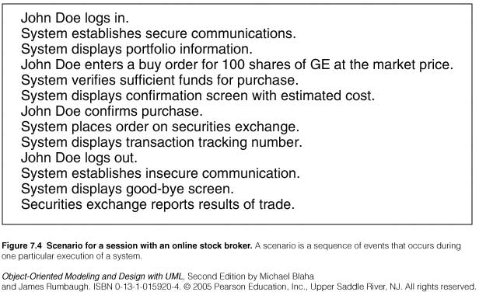
Scenarios
› Writing a scenario
Identify the objects involved
Determine the sender and the receiver of each message
Determine the sequence of the messages
Add activities

Slide 48
Sequence diagrams
Sequence diagrams are part of the UML and are used to model the interactions between the actors and the objects within a system.
A sequence diagram shows the sequence of interactions that take place during a particular use case or use case instance.
The objects and actors involved are listed along the top of the diagram, with a dotted line drawn vertically from these.
Interactions between objects are indicated by annotated arrows.

Slide 49
Sequence Diagrams
› A sequence diagram shows the participants in an interaction and the sequence of messages among them
› A sequence diagram shows the interaction of a system with its actors to perform a use case

Slide 50
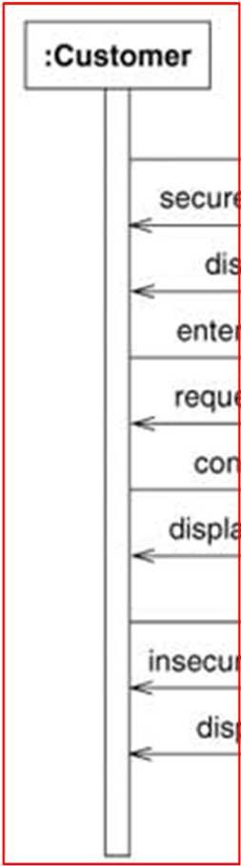
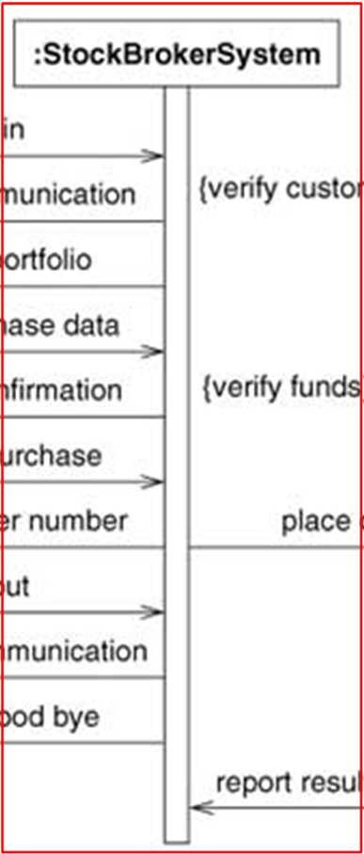
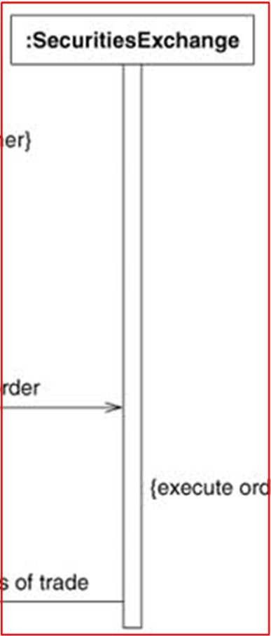
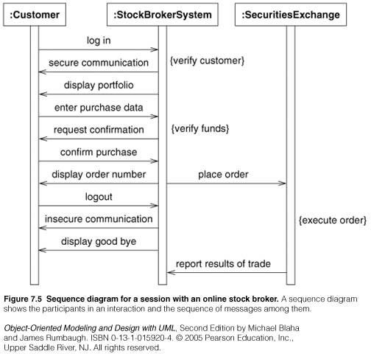
Sequence Diagrams (Asynchronous)
Actors as well as the System are represented by a vertical line called a lifeline

Slide 51
Sequence Diagrams (Asynchronous)
Time proceeds from top to bottom but spacing is irrelevant

Slide 52

Sequence Diagrams (Asynchronous)
Each message is a horizontal arrow from the sender to the receiver

Slide 53
Sequence Diagrams (Asynchronous)
Are used for high level interactions
Can contain concurrent signals
Stock Broker System sends messages to Customer and Securities Exchange concurrently
Signals between participants do not need to alternate
Stock Broker System sends “secure communication” followed by “display portfolio”

Slide 54
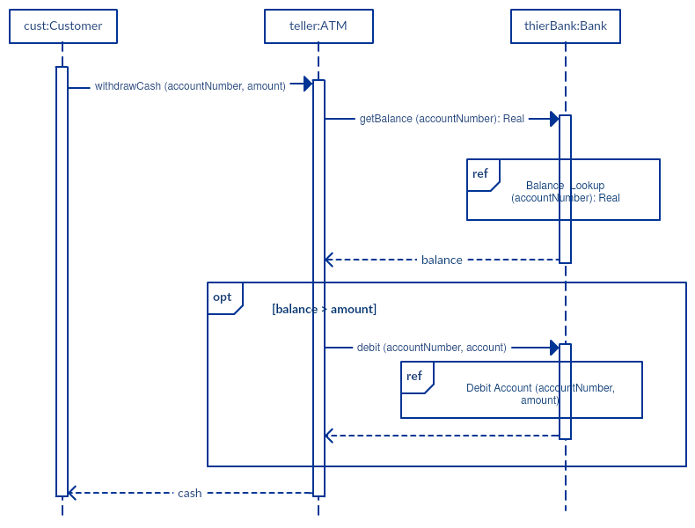

Slide 55
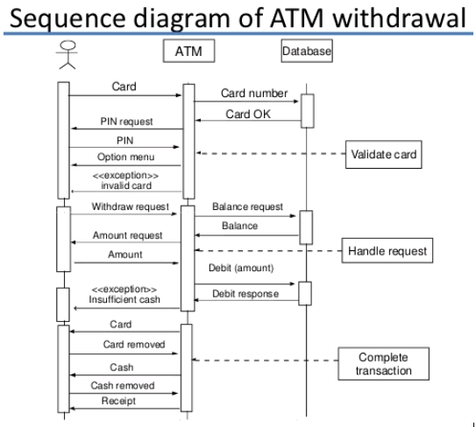

Slide 56
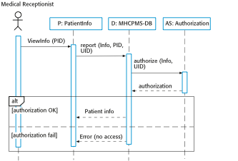
Sequence diagram for View patient information

Slide 57
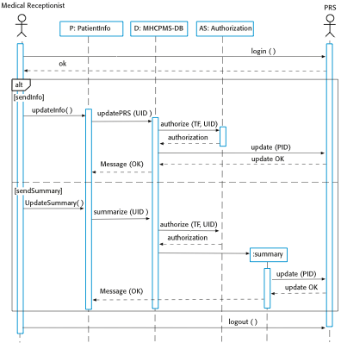
Sequence diagram for Transfer Data

Slide 58
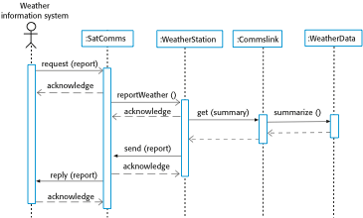
Sequence diagram describing data collection(WEATHER STATION)

Slide 59
Sequence diagram describing data collection

Slide 60
State diagrams
State diagrams are used to show how objects respond to different service requests and the state transitions triggered by these requests.
State diagrams are useful high-level models of a system or an object’s run-time behavior.
You don’t usually need a state diagram for all of the objects in the system. Many of the objects in a system are relatively simple and a state model adds unnecessary detail to the design.

Slide 61
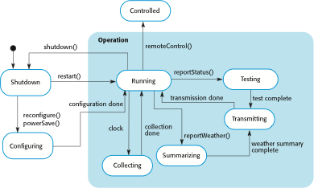
Weather station state diagram

Slide 62
Interface specification
Object interfaces have to be specified so that the objects and other components can be designed in parallel.
Designers should avoid designing the interface representation but should hide this in the object itself.
Objects may have several interfaces which are viewpoints on the methods provided.
The UML uses class diagrams for interface specification but Java may also be used.

Slide 63
What Is an Interface?
As you've already learned, objects define their interaction with the outside world through the methods that they expose. Methods form the object's interface with the outside world; the buttons on the front of your television set, for example, are the interface between you and the electrical wiring on the other side of its plastic casing. You press the "power" button to turn the television on and off.
In its most common form, an interface is a group of related methods with empty bodies. A bicycle's behavior, if specified as an interface, might appear as follows:
interface Bicycle {
// wheel revolutions per minute
void changeCadence(int newValue);
void changeGear(int newValue);
void speedUp(int increment);
void applyBrakes(int decrement);
}

Slide 64

Weather station interfaces

Slide 65
Key points
Software design and implementation are inter-leaved activities. The level of detail in the design depends on the type of system and whether you are using a plan-driven or agile approach.
The process of object-oriented design includes activities to design the system architecture, identify objects in the system, describe the design using different object models and document the component interfaces.
A range of different models may be produced during an object-oriented design process. These include static models (class models, generalization models, association models) and dynamic models (sequence models, state machine models).
Component interfaces must be defined precisely so that other objects can use them. A UML interface stereotype may be used to define interfaces.

